Slide 1
refrAIme
Intelligent CBT Journaling
Sineli Gamage, Hannah MacDonald, Shyam Patel, Michael Garfagnoli, Bradley Igercich

Slide 2
1 in 5 U.S. adults live with a mental illness (59.3M in 2022)
AI-powered journaling tool rooted in Cognitive Behavioral Therapy (CBT)
Supports users to reframe unhealthy thoughts and strengthen positive ones
If 15% of adults are open to journaling, ~9M potential users
Problem
Solution
Impact
Notes:
Sineli

Slide 3
Target Users
Reflective, Therapy-Adjacent Young Adults
About
Motivation
Pain Points
Emotionally curious Young Adults (18-35)
Build emotional awareness
Find calm or perspective after a busy day
Open to expressing feelings privately
Lose consistency without emotional prompts
Want a real reflective experience that feels friendly and personal
Notes:
Our target users are Reflective, Therapy-Adjacent Young Adults
About: who are emotionally curious and follow wellness culture. They already explore self-care and productivity tools because they value reflection but often have a hard time sticking to journaling because the lack of structure and engagement.
Motivation: These users are motivated by building emotional awareness, finding peace or perspective after long days, and are open to expressing feelings privately
Pain Points: Our users want to reflect and grown, but they struggle to stay consistent. They’re also looking for a space that feels safe and personal.

Slide 4
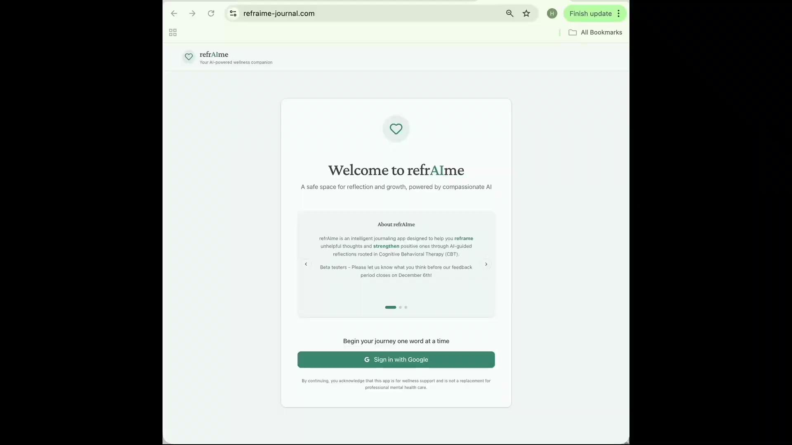
Notes:
Hannah
Introduction & Landing Page
The opportunity here is to create a journaling experience that fits how users think and feel. Our MVP delivers a clean, minimal design that feels safe and transparent.
So here on the landing page, we first explain what refraIMe is, and then we go on to talk about our recommendations for using refraime. And we also highlight our data privacy commitment upfront.
So the user will sign in with Google.
The Journaling Interface
So, once signed in, the user sees a calm writing interface. We provide CBT-based writing prompts to help the users get started.
So I'm going to go ahead and put a pre-generated journal entry into the text box. This is reflecting a user saying that they're stressed about starting a new job, they're excited, but they don't know if they're going to be good enough or figure things out fast enough, and that's ultimately what is weighing them down.
So, go ahead and press 'Reflect with AI'.
The AI Reflection Session
here I'll click 'Start AI Reflection,' and it immediately explains its approach, that it uses CBT practices.
So the AI reads the journal entry, which touches on how they've got a sense of excitement and also anxiety from the journal entry. And also lets the user know that it's normal to feel this way. And then to help guide the reflection, it asks, 'What are some specific things that are causing you to worry about not being good enough?'
So I'm going to put this pre-generated prompt talking about how the user is worried about not picking things up fast enough or making mistakes early on. And I'll send that to the AI.
The AI again takes the response, tells the user that it seems like they're concerned about meeting expectations. And that again, that this is common for them to feel. It then asks another guiding question, like 'What are some specific examples of situations where you might feel this pressure to prove yourself?'"
Feedback & Citations
So we'll just go ahead and end the session. So if the user wants to do that, there's a feedback popup that shows. It's a quick way for them to share what's working and what could be better.
And based on user feedback, people wanted to know what the AI is being taught. So we added this Citations page right here, that any user can go through and look at the sources that we used.
Privacy & User Control
And we also made a Privacy statement a priority. It really shows what we're doing with the data, how we store it.
Users can go and view or delete their past entries and the conversations -They also can go ahead and delete their account as well.
So they have complete control over all of their data.
Conclusion
Our MVP demonstrates how we can create a journaling experience that's both therapeutic and trustworthy with a working AI, while maintaining transparency about data privacy and the sources behind our AI guidance

Slide 5
Data Privacy
Use
Encryption
Personal entries are never used to train our AI models.
Data is stored in an encrypted database, no access to third parties.
Deletion
No External Sharing
Users have the ability to request deletion of all their entries at any time.
Your entries never leave our system, they’re processed within our secure environment and never sent to external APIs.
Notes:
Sineli

Slide 6
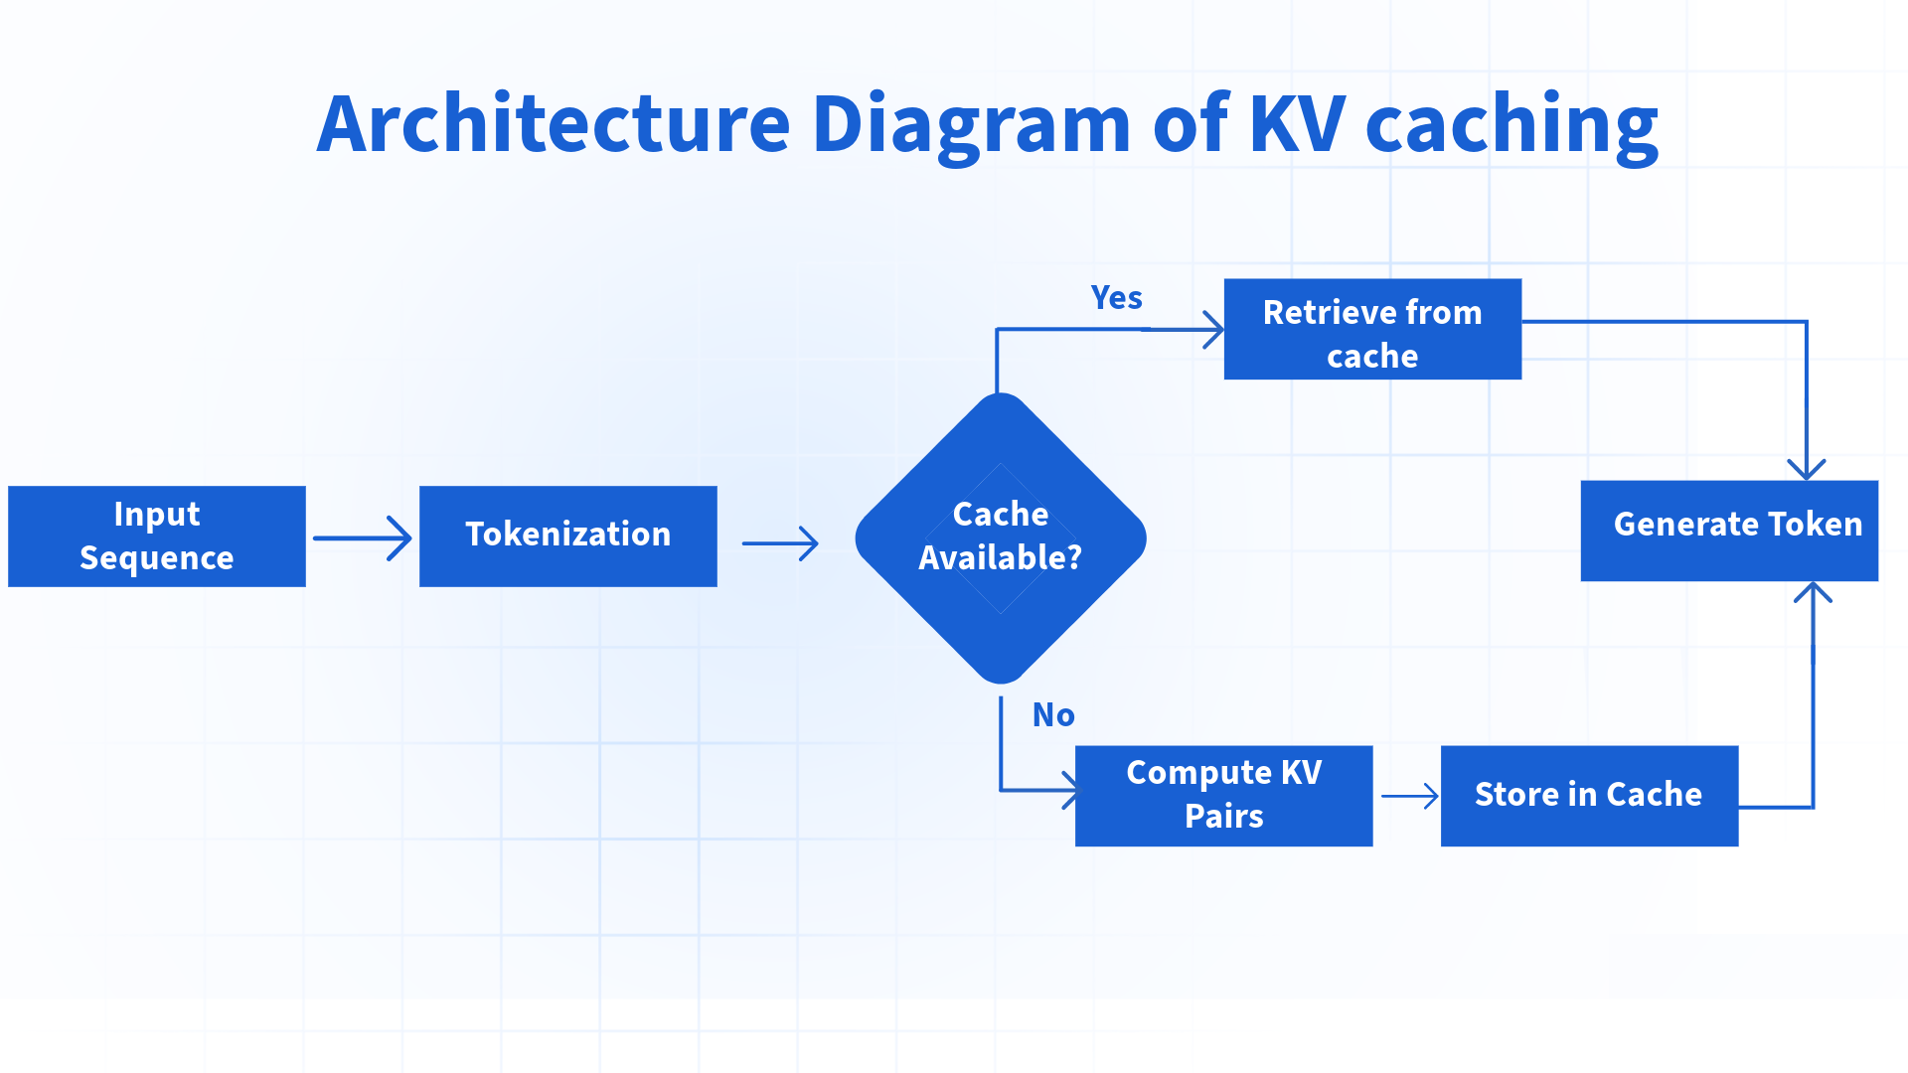
Model Configuration
Gemma2-9B-IT
4-bit AWQ
vLLM
  Continuous batching
  KV Caching in blocks
Notes:
Shyam
Between initial exploratory results and practical deployment concerns, we went with Gemma2 as our local model, specifically the instruction tuned version with 9 billion parameters.
We opted for 4-bit AWQ quantization, which keeps track of the most salient weights when quantizing to maintain as much accuracy as possible while reducing memory footprint.
Due to the causal attention from a decoder only architecture, we implemented KV Caching to avoid repeating calculations for tokens that have already been generated.
The model was served with vLLM, which enables efficient utilization of a GPU through continuous request batching as well as “blocks” of KV Cache with a certain token length. This allowed us to recycle cache between different requests up until a given prompt diverged, as opposed to needing an exact match on all prior tokens.

Slide 7
RAG Architecture
Data Ingestion
Extract & load CBT-related documents
Data Loading
Convert loaded text into embeddings
Summarization
Summarize user’s journal entry for key high-level themes
Data Retrieval
Retrieve CBT-relevant context and feed into the LLM
Response
LLM generates a fine-tuned response based upon CBT context
Notes:
Brad
The core of the journal experience is driven by a Retrieval Augmented Generation (or RAG) system. This system leverages a CBT-focused knowledge base to transform the user’s journal entry into reflective guiding questions to maximize their journaling experience.
The process happens in 5 distinct steps:
Data Ingestion
Data Loading
Journal Summarization
Data Retrieval
Finally, LLM response generation

Slide 8
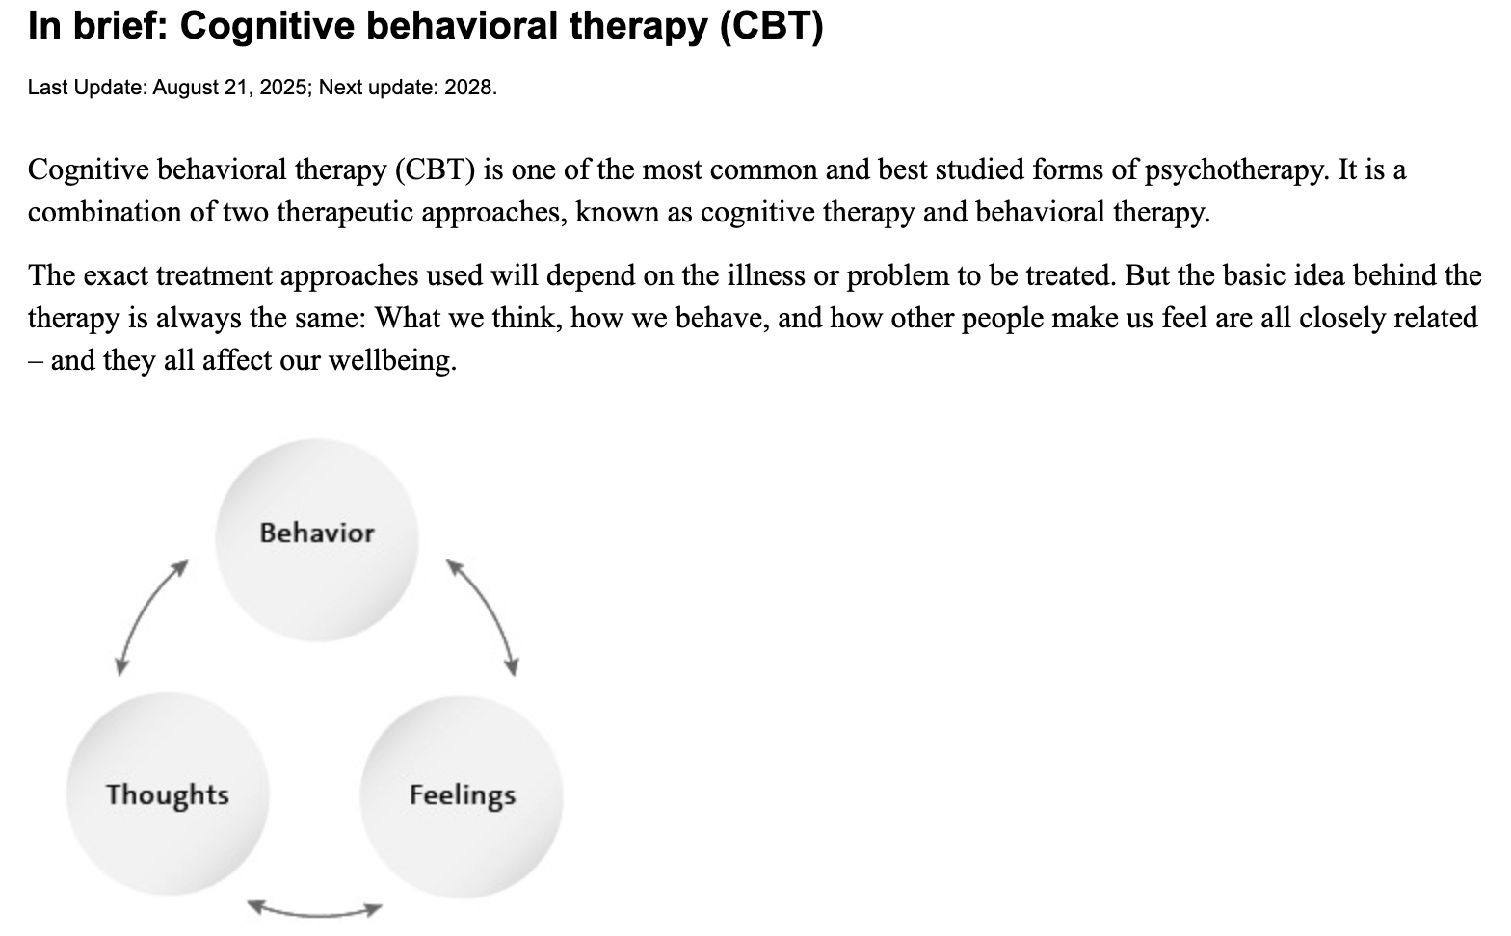
RAG: Ingestion
Pre-cleaned all CBT-related documents prior to loading in AWS.
Focused on loading documents that contain instructional information about CBT as opposed to worksheets.
Full Website
Scraped Text
Cognitive behavioral therapy (CBT) is one of the most common and best studied forms of psychotherapy. It is a combination of two therapeutic approaches, known as cognitive therapy and behavioral therapy. The exact treatment approaches used will depend on…
Notes:
Brad
First, our curated CBT-related documents are ingested into the system. To improve the accuracy of context retrieval, we pre-clean these documents before ingestion, removing extraneous material—such as bibliographies, graphs, and other nonessential content.
In building our CBT knowledge base, we prioritized medical journals and instructional articles rather than worksheet-style resources, ensuring the content provides clear, evidence-based guidance.

Slide 9
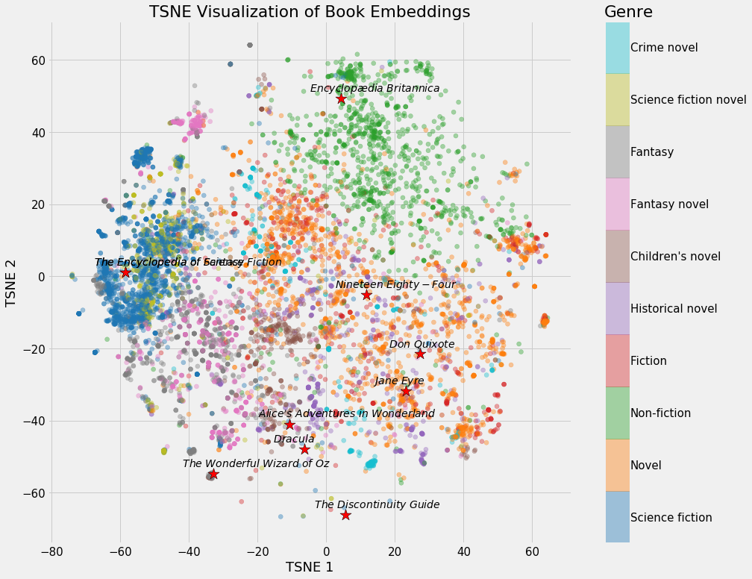
RAG: Loading
Embeddings are created for loaded CBT documents within Amazon Bedrock
Text is segmented into chunks of 384 tokens with a 50% overlap
Scraped Text
Embeddings
Cognitive behavioral therapy (CBT) is one of the most common and best studied forms of psychotherapy. It is a combination of two therapeutic approaches, known as cognitive therapy and behavioral therapy. The exact treatment approaches used will depend on…
Notes:
Brad
Next, these documents are converted and loaded into text embeddings within Amazon Bedrock. Through experimentation, we found that segmenting text into 384-token chunks with 50% overlap is the combination that yields the most reliable and contextually rich results for response generation.

Slide 10
RAG: Summarization
Journal entries are summarized by an LLM to capture key high-level themes and insights, providing a more accurate context and enabling CBT correlations to be drawn from meaningful patterns rather than unnecessary details
Journal Entry
Summary
“I just felt like he does not miss me the way that I miss him and that he really does not care about me the way that I care about him. I know that these things aren't true, but our conversation left me feeling frustrated and sad.”
The user expresses feelings of sadness and frustration stemming from perceived lack of reciprocation in their romantic relationship. … suggesting potential for cognitive distortions and catastrophizing.
Notes:
Brad
When a user submits a journal entry, it is first summarized to capture its key themes and overarching psychological trends for more accurate context retrieval, rather than getting lost in nuanced details.
In this journal entry, the user is writing about a time when she felt her partner “does not miss me the way that I miss him.” She continues, “I know these feelings aren’t true, but that their conversation left her feeling frustrated and sad.”
The summarization hits on these key ideas, recognizing that the user “expresses feelings of sadness and frustration stemming from perceived lack of reciprocation in their romantic relationship” and it points out the potential for cognitive distortions and catastrophizing.

Slide 11
RAG: Retrieval
Finds the chunks of text that contain the most relevant CBT information to the users journal entry
This context is fed into the prompt to provide CBT-relevant information for the LLM to use in its output
Journal Entry
Retrieved Context
“I just felt like he does not miss me the way that I miss him and that he really does not care about me the way that I care about him. I know that these things aren't true, but our conversation left me feeling frustrated and sad.”
A woman who has a core belief that she is “unlovable” may also
believe that if she works hard to please her partner, he may love her anyway. However, if her partner breaks up with her, her core belief of being “unlovable” may be reactivated, and increase her vulnerability to depression or anxiety.
Notes:
Brad
The summarized journal entry is then used to retrieve the most semantically relevant CBT information from the embedded knowledge base.
Using that same journal entry, the retrieved context is spot on.
It touches on the idea of a person who has a core belief that they are “unlovable” and how they might work hard to please their partner in an effort to win them over. If these feelings aren’t reciprocated and their partner breaks up with them, it can lead to increased feelings of vulnerability and depression or anxiety.

Slide 12
RAG Model Response Example
It sounds like working many tasks was challenging at times. Have you noticed any specific thoughts during those moments when it felt particularly frustrating? Reframing these thoughts could make things feel less overwhelming. For example, instead of thinking "I can't handle this," maybe try telling yourself, "This situation feels difficult right now, but I have the skills to manage." How does that sound as a possible way to reframe your thoughts next time you face challenges at work?
Sounds like quite a busy day! Frustration is normal when things get tough, especially when we're juggling multiple tasks. Can you think of any situations where your thoughts might have been exaggerated or all-or-nothing during those difficult moments?
Baseline (No RAG & Limited Prompt Eng)
RAG Model Results
Implicitly applies CBT through gentle questioning and normalization
Overly clinical; giving direct CBT advice
Encourages self-reflection with open-ended questions
Tells the user what to do
Feels artificial or scripted. Longer.
Warm and conversational. Feels more natural and human. Shorter.
Notes:
Michael
Here you can see what our model’s responses look like with and without RAG. In this example, a user journals about how their work day was difficult due to needing to juggle multiple tasks.
On the left is our baseline mode without RAG. The response is much longer, a bit too clinical and tries to tell the user exactly what to do. It reads “...”. While it’s technically accurate, it sounds more like a textbook than an empathetic journaling companion.
On the right is our improved model after introducing RAG and a ton of prompt refinement. This version is shorter, more natural, and more emotionally attuned. It reads “...”. Instead of instructing the user, it first validates their feelings and then asks a gentle, open-ended question that encourages reflection.
After talking with a CBT domain expert, we learned two key principles that guided this improvement: keep responses concise, and don’t explicitly mention CBT frameworks.

Slide 13
From Model Output to User Action
📝 Journal Entry
🤖 RAG Retrieval
Long-Term Value
💬 AI Response
✨ User Guided to Insight
User Journey
Identifies key cognition and retrieves CBT guidance to inform response
Over time, users internalize CBT skills:
→ Self-identify distortions independently
→ Apply learned techniques
→ Build lasting emotional regulation skills
Response offers validation and guides the user to reframe their thoughts
• Awareness of cognitive pattern
• Alternative explanations to consider
• Transferable skill for future situations
Notes:
Michael
I wanted to take a moment to show how our model output is actually useful for our users.
So to reiterate: a user writes a journal entry, the RAG retrieves relevant information from our CBT knowledge base and the LLM generates a response.
Then, the user is guided to insight. They start to see the pattern of how they think and consider alternative explanations for their thoughts
And that is where the long-term value truly comes in. Over time, users internalize these skills: They start catching their own distortions. They're journaling and start applying the techniques they have learned from previous sessions independently until this becomes automatic and more a part of how they generally think.
What we aim to provide is a friend that helps you build better habits of thinking.
So now, let's talk evaluation.

Slide 14
Evaluation Methodology: Cognitive Therapy Rating Scale
LLM-As-A-Judge
LLM scores 50 User/Journal Assistant dialogues from 1-6 using the Cognitive Therapy Rating Scale on:
Understanding
Interpersonal Effectiveness
Guided Discovery
Focusing on Key Cognitions
Application of CBT Methods
Why This Metric:
Widely used in CBT therapy assessment
Measures therapeutic competence across multiple key dimensions
Allows comparison to other LLM-generated benchmarks from similar work
Notes:
Michael
For evaluation, we used an evaluation rubric called the Cognitive Therapy Rating Scale. It's a standardized assessment tool used in clinical practice and CBT training programs where it scores various metrics on a scale of 1-6.
We have an LLM acting as a judge to score 50 user/assistant dialogues using that exact same 1-6 scale.
Now, why did we use this scale specifically? Three reasons:
One - it's widely used.
Two - it's comprehensive. We're measuring therapeutic competence across multiple dimensions.
Three - benchmarking. Other papers in this space have used similar frameworks, so we can compare our results to existing work.
Note:
Understanding - does it understand what the user is saying?
Interpersonal effectiveness - does it feel warm and supportive?
Guided discovery - is it asking good guiding questions?
Focusing on key cognitions - is it zeroing in on the important thoughts?
Application of CBT methods - is it actually using CBT frameworks?

Slide 15
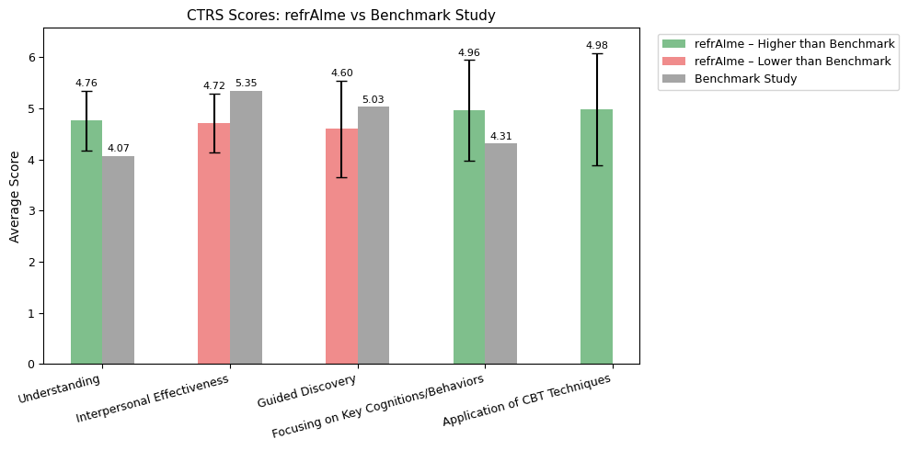
Evaluation Results: Cognitive Therapy Rating Scale
Key Findings
Exceeded benchmark study in Understanding and Focusing on Key Cognitions metrics
Model is using the CBT frameworks from the RAG Retrieval
Notes:
Michael
Here are our evaluation results on 50 separate dialogues of 3+ turns. We're doing really well on Understanding and Focusing on Key Cognitions. The model knows how to spot the core problem and stay on it. And while we don’t have a baseline to compare to on Application of CBT Techniques, we are performing very well there.
The takeaway is that the model is understanding what to discuss and using CBT to guide the user through those key thoughts. It's doing the therapy part right.

Slide 16
Real-World Evaluation Results
Users
How emotionally supportive and helpful was this session?
How well did this session help you reflect on your thoughts or feelings?
What could have made this session more helpful or relevant?
26
1 = Not at all 5 = Extremely
1 = Not at all 5 = Very Well
“Replies were consistent and polite”
“Feels like it would’ve just continued to ask questions forever”
3.8
4.0
Entries
54
Avg. Number of AI Exchanges per Session
Avg. Entry Length
2.9 turns
302 chars
Feedback
Key Learnings:
Users find the app easy to use, AI asks good questions
A gap between user expectations and app functionality
29
Notes:
Sineli

Slide 17
Key Technical Takeaways
Rigid Input Schema
  Helps avoid hallucinations; Properly organize info in large prompts
RAG Document Selection
  Perspective matters, not just general subject matter
Model Matters!
Model | Hallucination Frequency | Takeaways
Gemma 9B | Low | High quality responses ; Reliable performance
Qwen 14B | Low (Colab), Medium (Langchain API) | Best quality responses; Inconsistent performance with Langchain AI schema
Mistral 7B | Medium | Decent quality responses; Frequent hallucinations
Llama 8B | High | Decent quality responses; Many hallucinations
Notes:
Shyam
So our key technical takeaways from this project are as follows:
A rigid input schema is critical when prompting our model with many different sources of information, such as journal entries and chat histories. It helps prevent hallucinations and ensures the model properly attributes a given piece of info to the correct source.
RAG document selection needs to be thoughtful. We can’t simply add documents with the relevant subject matter. Each retrieved chunk needs to contain useful context. For example, we attempted to use worksheets as docs in our knowledge base and those sources simply added questions and not additional information around the frameworks themselves that could be used to respond more effectively to the user.
Finally, model choice really mattered. Mistral (7B) and Llama (8B) produced frequent hallucinations, while Qwen (14B) and Gemma (9B) were much more stable in the notebooks. But once we moved into deployment with LangChain, Qwen’s consistency dropped, while Gemma remained reliably accurate. In the end, we chose Gemma because it gave us the best balance of quality, stability, and low hallucination rates across the entire pipeline.

Slide 18
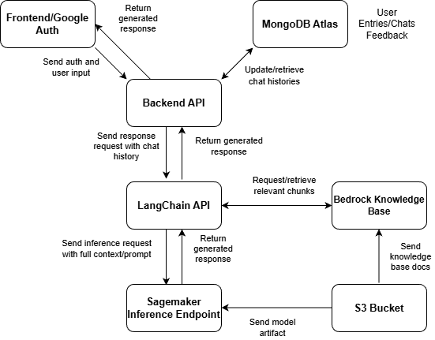
Deployment
Notes:
Shyam
Here is the high-level architecture of the entire system behind the product. The core of the system is on AWS with a Sagemaker inference endpoint hosting and running Gemma2 as well as a Bedrock knowledge base that provides chunks of context for each invocation of Gemma2 on Sagemaker. There are multiple API’s to handle user inputs, chat histories, and generated text to build prompts, request inference, and return an appropriate response to the user.
PREVIOUS VERSION, DON’T READ!
Here is the high-level architecture of the entire system behind the product. We have the following components:
A Sagemaker inference endpoint that is running the model
A Bedrock knowledge base to return context relevant to the latest user input
An S3 bucket to hold model artifacts and documents for these systems
A frontend that displays a web page, handles user authentication through Google, and accepts entries and responses
A MongoDB implementation that records all chat histories and returns them as needed for chat responses
A backend API that connects frontend requests with the chat histories in MongoDB and requests AI responses as needed
And to connect everything, a LangChain API that ingests a provided chat history and prompt from the backend API, retrieves the relevant chunks from Bedrock, and then assembles the full context and prompt payload to send the final request to the Sagemaker inference endpoint. The response returned to this API is propagated all the way through to the front end.
The frontend with the google authentication and the MongoDB implementation are both outside of AWS, every other component is deployed on AWS.

Slide 19

Roadmap
Track mood
Speech-to-text
Handwritten notes-to-text
Email reminders
About CBT page
Test Users
Features
Model
Improve ability of users to ask AI questions
Provide relevant worksheets & resources
Allow users to highlight parts of their journal entry for AI to analyze
Notes:
Sineli

Slide 20
Our Mission
Our Mission:
Empower users to take small, daily steps toward better mental health through AI-guided journaling rooted in Cognitive Behavioral Therapy.
Goal:
Build a tool that feels less like an app and more like a supportive friend that helps users think, feel, and grow.
Notes:
Hannah
“With refrAIme our mission is to ..”

Slide 21
Thank You!
Notes:
Hannah
“With refrAIme our mission is to ..”

Slide 22
Contributions
Sineli: Backend
Hannah: Frontend
Brad: RAG Pipeline
Michael: Prompt Engineering, Evaluation
Shyam: LLM, Deployment
Notes:
Hannah
“With refrAIme our mission is to ..”

